Slide 1
Comparator

Slide 2
Two-Bit Comparator
A B C D LT EQ GT
0 0 0 0 0 1 0
0 1 1 0 0
1 0 1 0 0
1 1 1 0 0
0 1 0 0 0 0 1
0 1 0 1 0
1 0 1 0 0
1 1 1 0 0
1 0 0 0 0 0 1
0 1 0 0 1
1 0 0 1 0
1 1 1 0 0
1 1 0 0 0 0 1
0 1 0 0 1
1 0 0 0 1
1 1 0 1 0
N1
A
LT EQ GT
A B < C D A B = C D A B > C D
B
N2
C
D
block diagram
and
truth table
we'll need a 4-variable Karnaugh map for each of the 3 output functions

Slide 3
Two-Bit Comparator (cont’d)
A
A
A
0 0
1 0
0 0
0 0
1 0
0 1
0 0
0 0
0 1
0 0
1 1
1 1
D
D
D
1 1
1 1
0 1
0 0
0 0
0 0
1 0
0 1
0 0
0 0
0 0
1 0
C
C
C
B
B
B
K-map for LT
K-map for EQ
K-map for GT
LT =
EQ =
GT =
A' B' D + A' C + B' C D
A'B'C'D' + A'BC'D + ABCD + AB'CD’
= (A xnor C) • (B xnor D)
B C' D' + A C' + A B D'

Slide 4
Equality Comparator
XNOR
X Y Z
0 0 1
0 1 0
1 0 0
1 1 1
X
Z
Y
Z = X XNOR Y

Slide 5
4-bit Equality Detector
A[3..0]
Equality
Detector
A_EQ_B
B[3..0]

Slide 6
4-Bit Equality Comparator
A0
C0
B0
A1
C1
B1
A_EQ_B
A2
B2
C2
A3
B3
C3

Slide 7
4-bit Magnitude Comparator
A_LT_B
A[3..0]
Magnitude
Detector
A_EQ_B
B[3..0]
A_GT_B

Slide 8
Magnitude Comparator
How can we find A_GT_B?
How many rows would a truth table have?
2⁸ = 256!

Slide 9
Magnitude Comparator
Find A_GT_B
If A = 1001 and
B = 0111
is A > B?
Why?

Slide 10
Magnitude Comparator
Find A_GT_B
Because A3 > B3
i.e. A3 . B3’ = 1
If A = 1001 and
B = 0111
is A > B?
Why?
Therefore, one term in the
logic equation for A_GT_B is
A3 . B3’

Slide 11
Magnitude Comparator
A_GT_B = A3 . B3’
+ …..
Because A3 = B3 and
A2 > B2
i.e. C3 = 1 and
A2 . B2’ = 1
If A = 1101 and
B = 1011
is A > B?
Why?

Slide 12
Magnitude Comparator
A_GT_B = A3 . B3’
+ …..
Because A3 = B3 and
A2 > B2
i.e. C3 = 1 and
A2 . B2’ = 1
If A = 1101 and
B = 1011
is A > B?
Why?
Therefore, the next term in the
logic equation for A_GT_B is
C3 . A2 . B2’

Slide 13
Magnitude Comparator
A_GT_B = A3 . B3’
+ C3 . A2 . B2’
+ …..
Because A3 = B3 and
A2 = B2 and
A1 > B1
i.e. C3 = 1 and C2 = 1 and
A1 . B1’ = 1
If A = 1010 and
B = 1001
is A > B?
Why?
Therefore, the next term in the
logic equation for A_GT_B is
C3 . C2 . A1 . B1’

Slide 14
Magnitude Comparator
A_GT_B = A3 . B3’
+ C3 . A2 . B2’
+ C3 . C2 . A1 . B1’
+ …..
Because A3 = B3 and
A2 = B2 and
A1 = B1 and
A0 > B0
i.e. C3 = 1 and C2 = 1 and
C1 = 1 and A0 . B0’ = 1
If A = 1011 and
B = 1010
is A > B?
Why?
Therefore, the last term in the
logic equation for A_GT_B is
C3 . C2 . C1 . A0 . B0’

Slide 15
Magnitude Comparator
A_GT_B = A3 . B3’
+ C3 . A2 . B2’
+ C3 . C2 . A1 . B1’
+ C3 . C2 . C1 . A0 . B0’

Slide 16
Magnitude Comparator
Find A_LT_B
A_LT_B = A3’ . B3
+ C3 . A2’ . B2
+ C3 . C2 . A1’ . B1
+ C3 . C2 . C1 . A0’ . B0

Slide 17
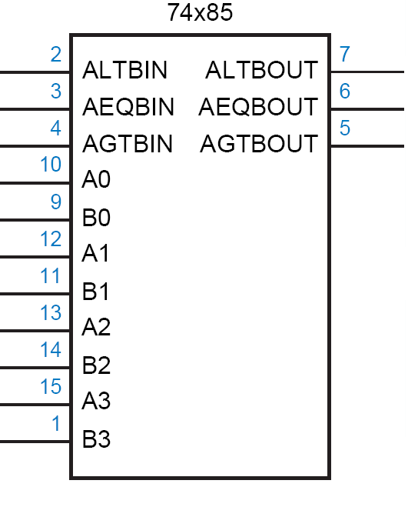
TTL 74x85
4
A
4
B
lt
l
eq
e
gt
g

Slide 18
TTL 74x85
if (A>B) lt=0, eq=0, gt=1
if (A<B) lt=1, eq=0, gt=0
if (A=B) lt=l, eq=e, gt=g
The three l, e and g inputs are used when cascading.
4
A
4
B
lt
l
eq
e
gt
g

Slide 19
Comparator (continued…)
Let us now cascade four of the 74x85 to construct a 16 bit comparator.
Exercise: Analyze it.

Slide 20
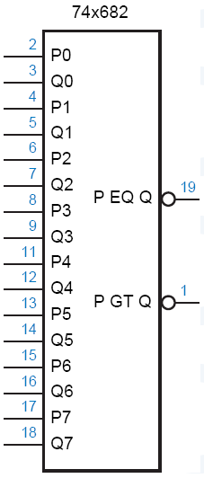
TTL 74x682
8-bit Comparator
Arithmetic conditions derived from 74x682 outputs?
And their circuits?

Slide 21
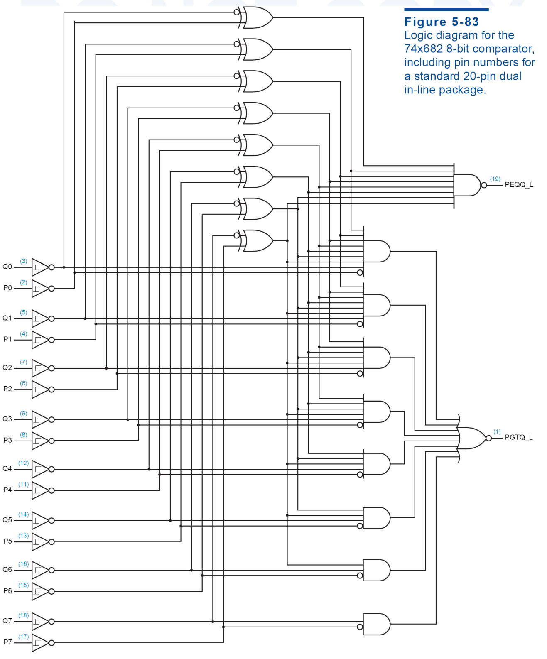

Slide 22
Maximum Finder
Design a maximum finder
a
4
b
4

Slide 23
Maximum Finder
Design a maximum finder

